Slide 1
Cs-381 Software Engineering
Course Instructor: Dr. Shazia Arshad
Notes:
Welcome to all of you in this course. I am Dr. Shazia Arshad. I will be your instructor for this course.

Slide 2
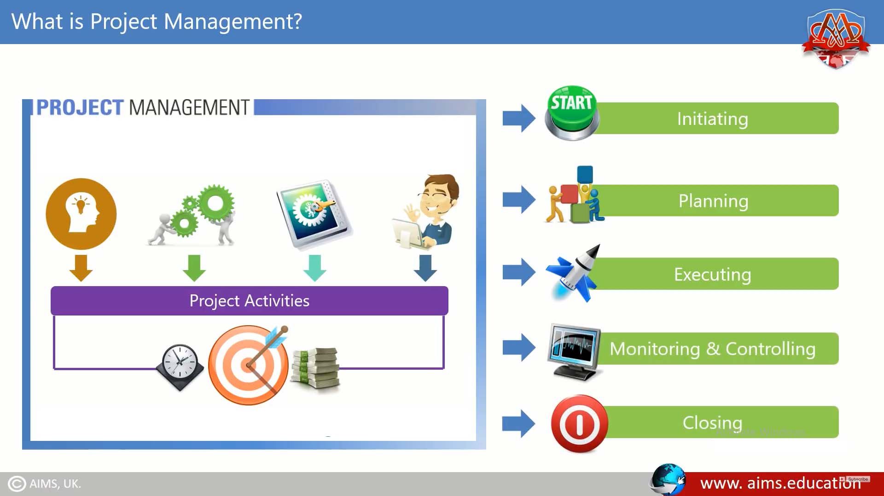
Notes:
To define project management, one must define a project.
What is a Project?
Anything that has a start, a finish and produces a deliverable is a project.
Project management, therefore, is the method by which a project is planned, monitored, controlled and reported on—in other words, managed.

Slide 3
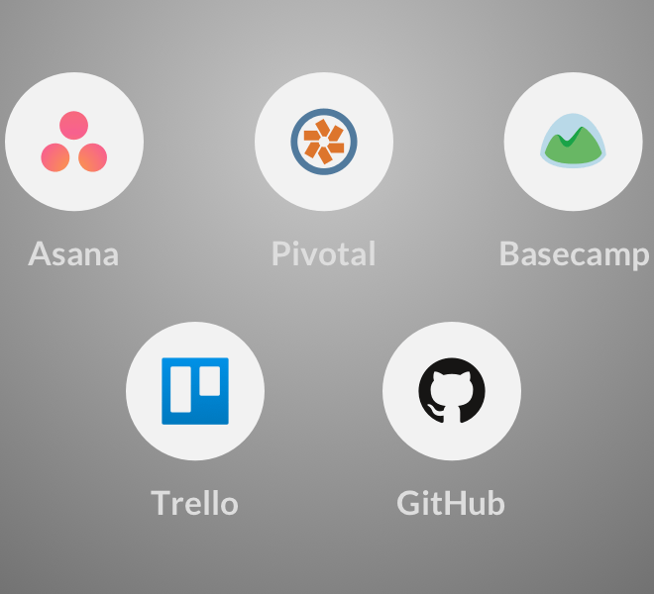
Project Management Tools
Asana
Jira
Trello
Active Collab
Redmine
Basecamp
GitHub
Pivotal

